Slide 1
Cryptography Failures
Past, Present, And Future
Josip Medved
medo64.com
@medo64
Notes:
Illustrations by Anita Medved.

Slide 2
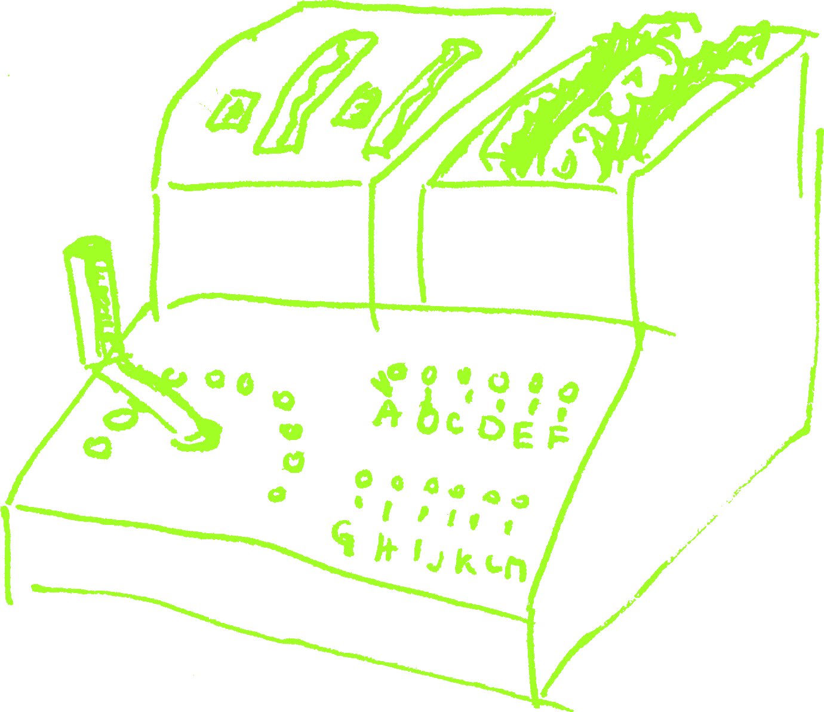
Content
A bit about historically significant ciphers
and how they were broken
How is encryption broken today?
What future brings?

Slide 3
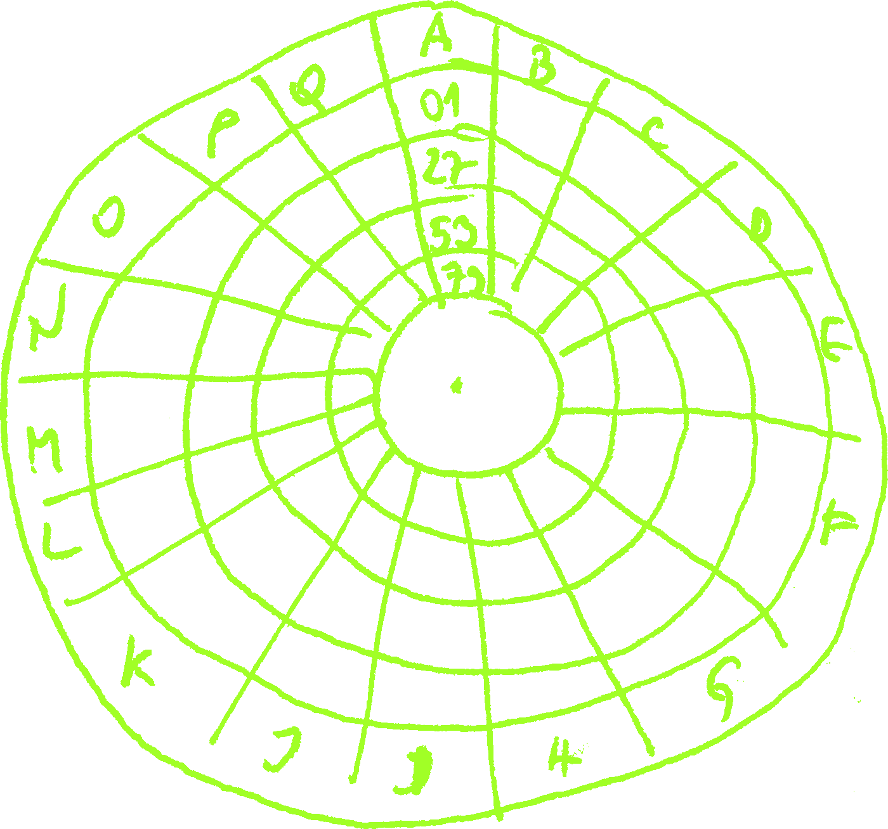
Caesar
Simple substitution cipher
plaintext: IBM; key: -1; ciphertext: HAL
I → H, B → A, M → L
Many variants
Susceptible to frequency analysis (Al-Kindi 9th century)
Notes:
Q&A:
Many variants – e.g. ROT-13
Resources:
https://en.wikipedia.org/wiki/Caesar_cipher
https://en.wikipedia.org/wiki/ROT13

Slide 4
Caesar: History
First known usage by Julius Caesar (cca 100 BC)
he also used a bit more complicated one – lost to history
Reasonably secure for the time
Used even in modern times
Notes:
Q&A:
Reasonably secure for the time – because nobody could read to start with :)
Resources:
https://en.wikipedia.org/wiki/Caesar_cipher

Slide 5
Caesar: Failure
2006: Bernardo Provenzano (mafia boss) used variation of it
A → 4, B → 5, C → 6, ...
caught :)
2011: Rajib Karim (terrorist)
used PGP personally
his Bangladeshi partners refused to use program made by “infidels”
Notes:
Resources:
https://www.theregister.co.uk/2006/04/19/mafia_don_clueless_crypto/
https://www.theregister.co.uk/2011/03/22/ba_jihadist_trial_sentencing/

Slide 6
Caesar: Lessons
Old “software” dies hard :)
Obfuscation is sometime ok
just don’t use it for anything important
Security is only as good as the weakest link
friends don’t let friends use weak ciphers
Notes:
Q&A:
Many variants – e.g. ROT-13
Resources:
https://en.wikipedia.org/wiki/Caesar_cipher
https://en.wikipedia.org/wiki/ROT13

Slide 7
Vigenère
Polyalphabetic substitution
plaintext: ABCD; key: KEY; ciphertext: KFAN
A → K, B → F, C → A, D → N
Notes:
Q&A:
Polyalphabetic substitution - essentially bunch of caesar ciphers interwoven together
Resources:
https://en.wikipedia.org/wiki/Vigenère_cipher

Slide 8
Vigenère: History
First described by Giovan Battista Bellaso in 1553
Called “Le chiffre indéchiffrable”
Friedrich Kasiski solved it in 1863
Charles Babbage broke it as early as 1846
Notes:
Q&A:
First described by Giovan Battista Bellaso - misattributed to Blaise de Vigenère in 19th century
Resources:
https://en.wikipedia.org/wiki/Vigenère_cipher

Slide 9
Vigenère: Failure
1892: Anarhists used variant called Gronsfeld/Beaufort
essentially just used letter/number combination
Notes:
Q&A:
Not too many failures because it was actually quite strong for the day and not commonly used as it was difficult to implement correctly.
if you get caught with it there is not much to deny it – pipe works for password recovery
Resources:
https://www.nku.edu/~christensen/092hnr304%20Gronsfeld%20and%20Beaufort.pdf

Slide 10
Vigenère: Lessons
Just because it looks undecipherable, it isn’t necessarily safe

Slide 11
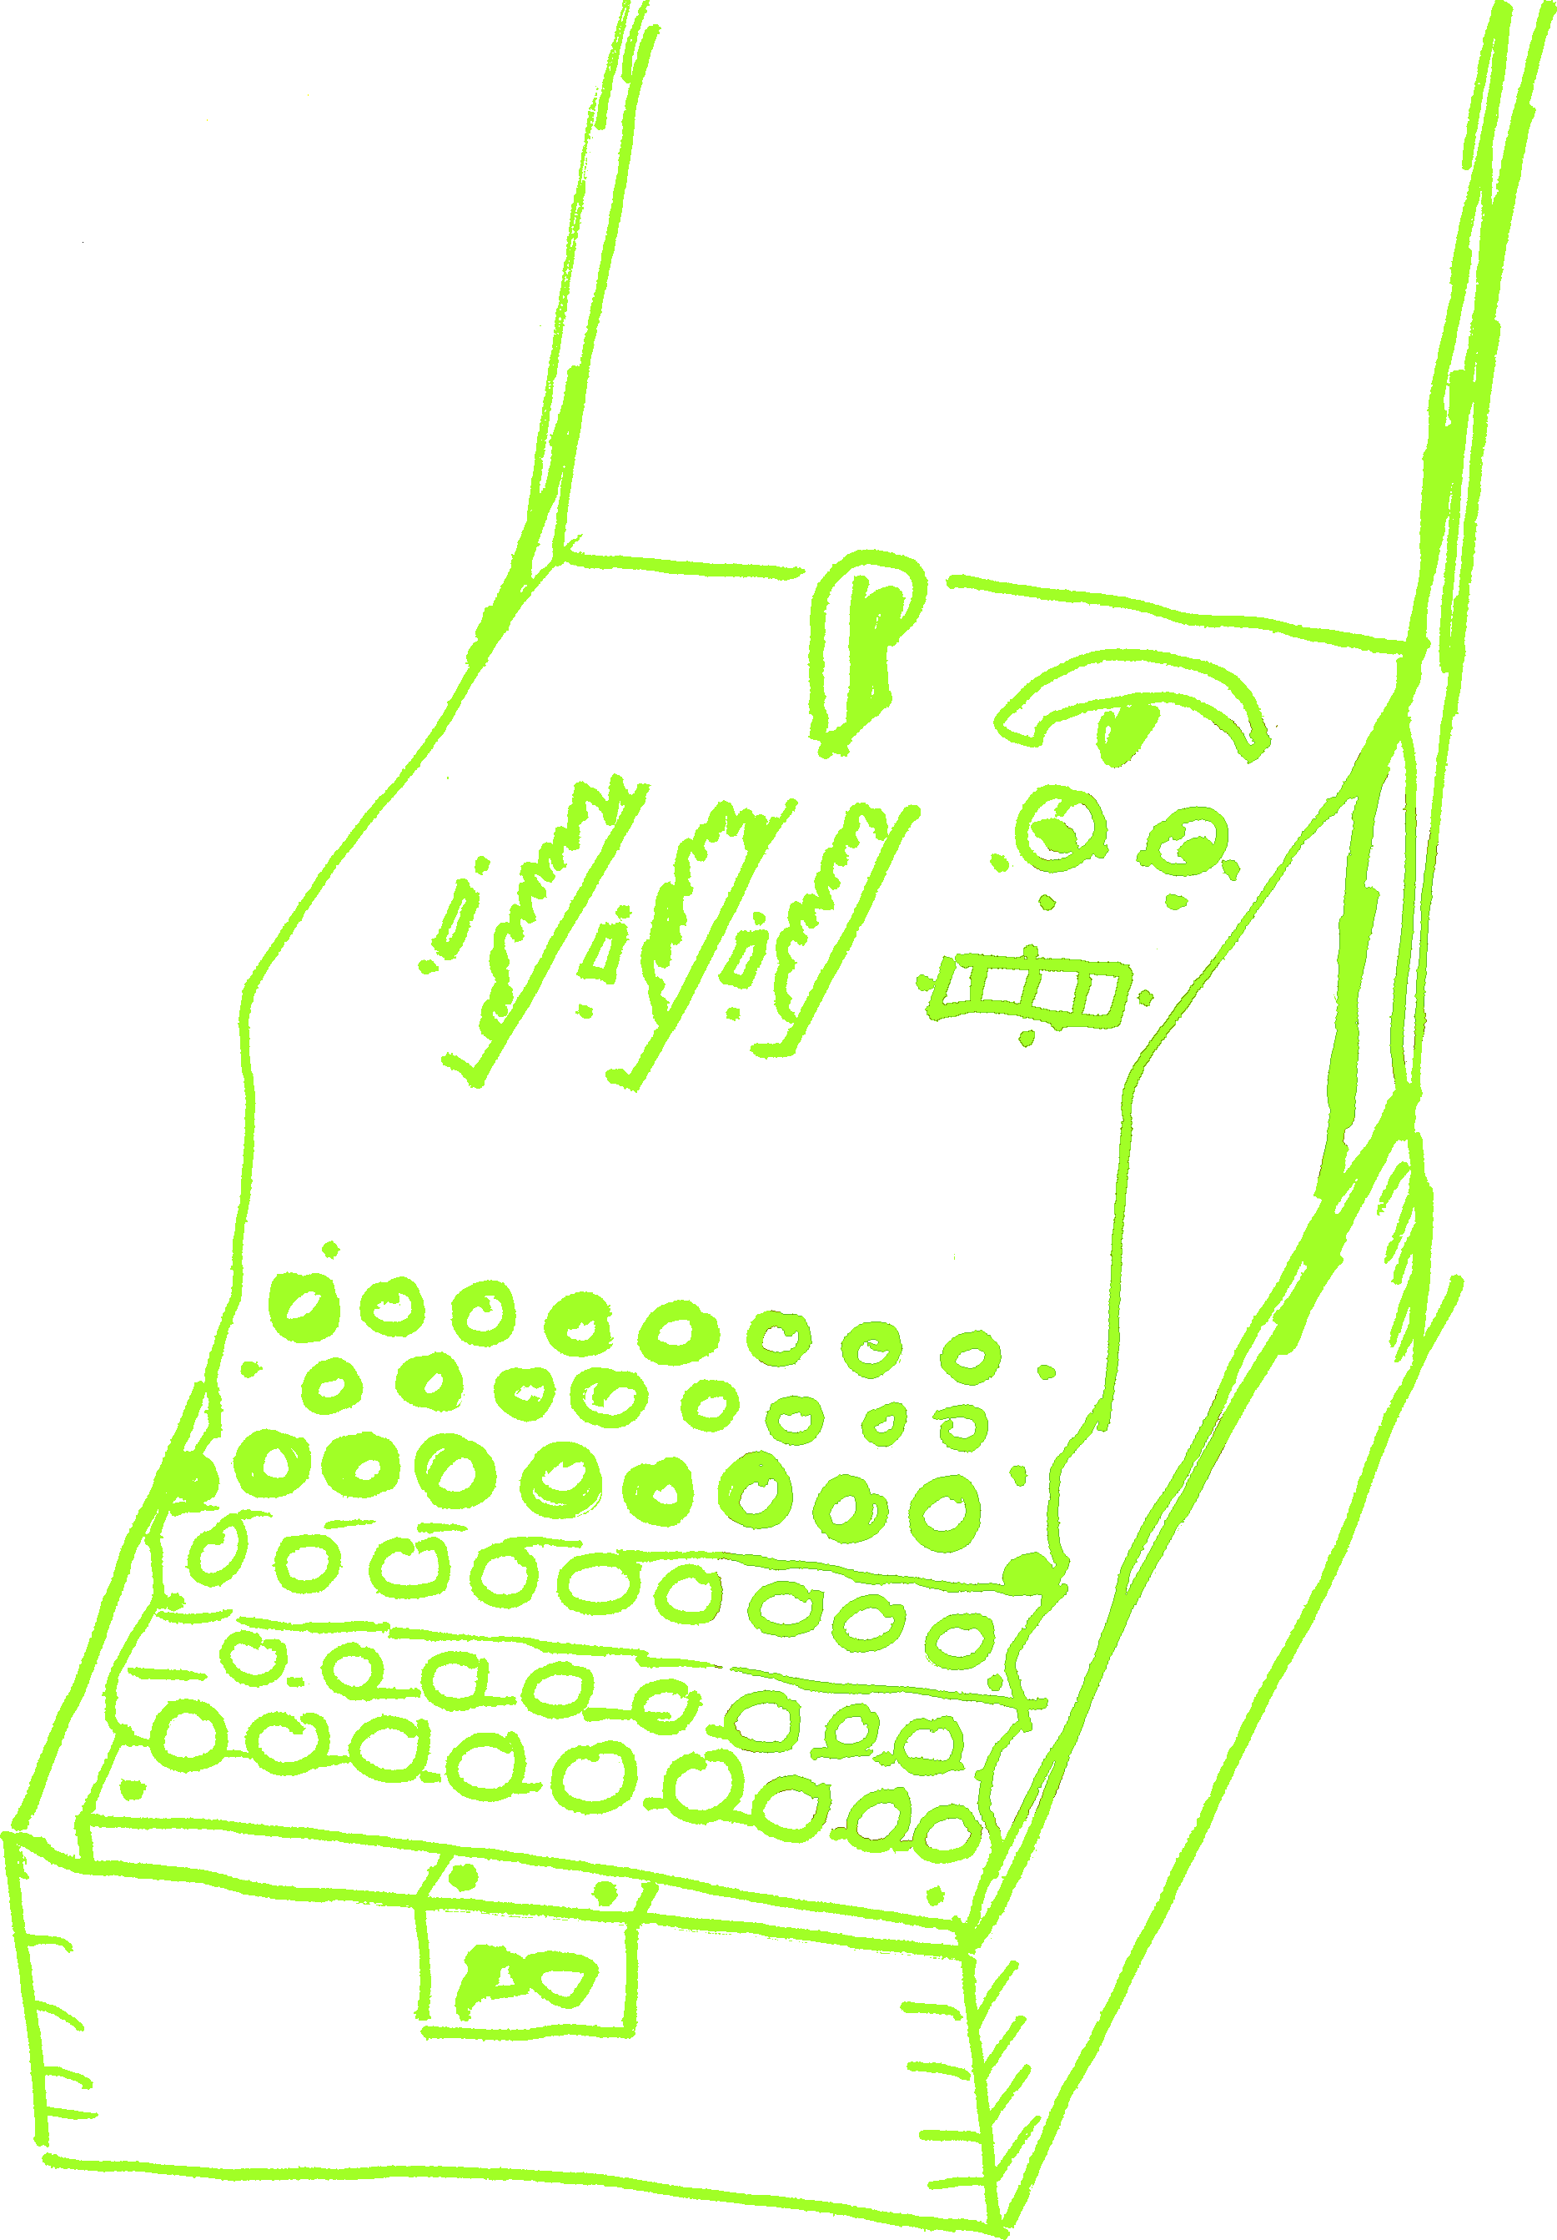
Enigma
Rotor stream cipher
Electro-mechanical in nature
Period of 16,900 letters (26*25*26)
as messages were usually in hundreds of letters, this meant no-repeat
Notes:
Q&A:
Electro-mechanical in nature – basically making electrical circuit through rotors
Period – Lorenz machine actually had period in billions
Resources:
https://en.wikipedia.org/wiki/Enigma_machine

Slide 12
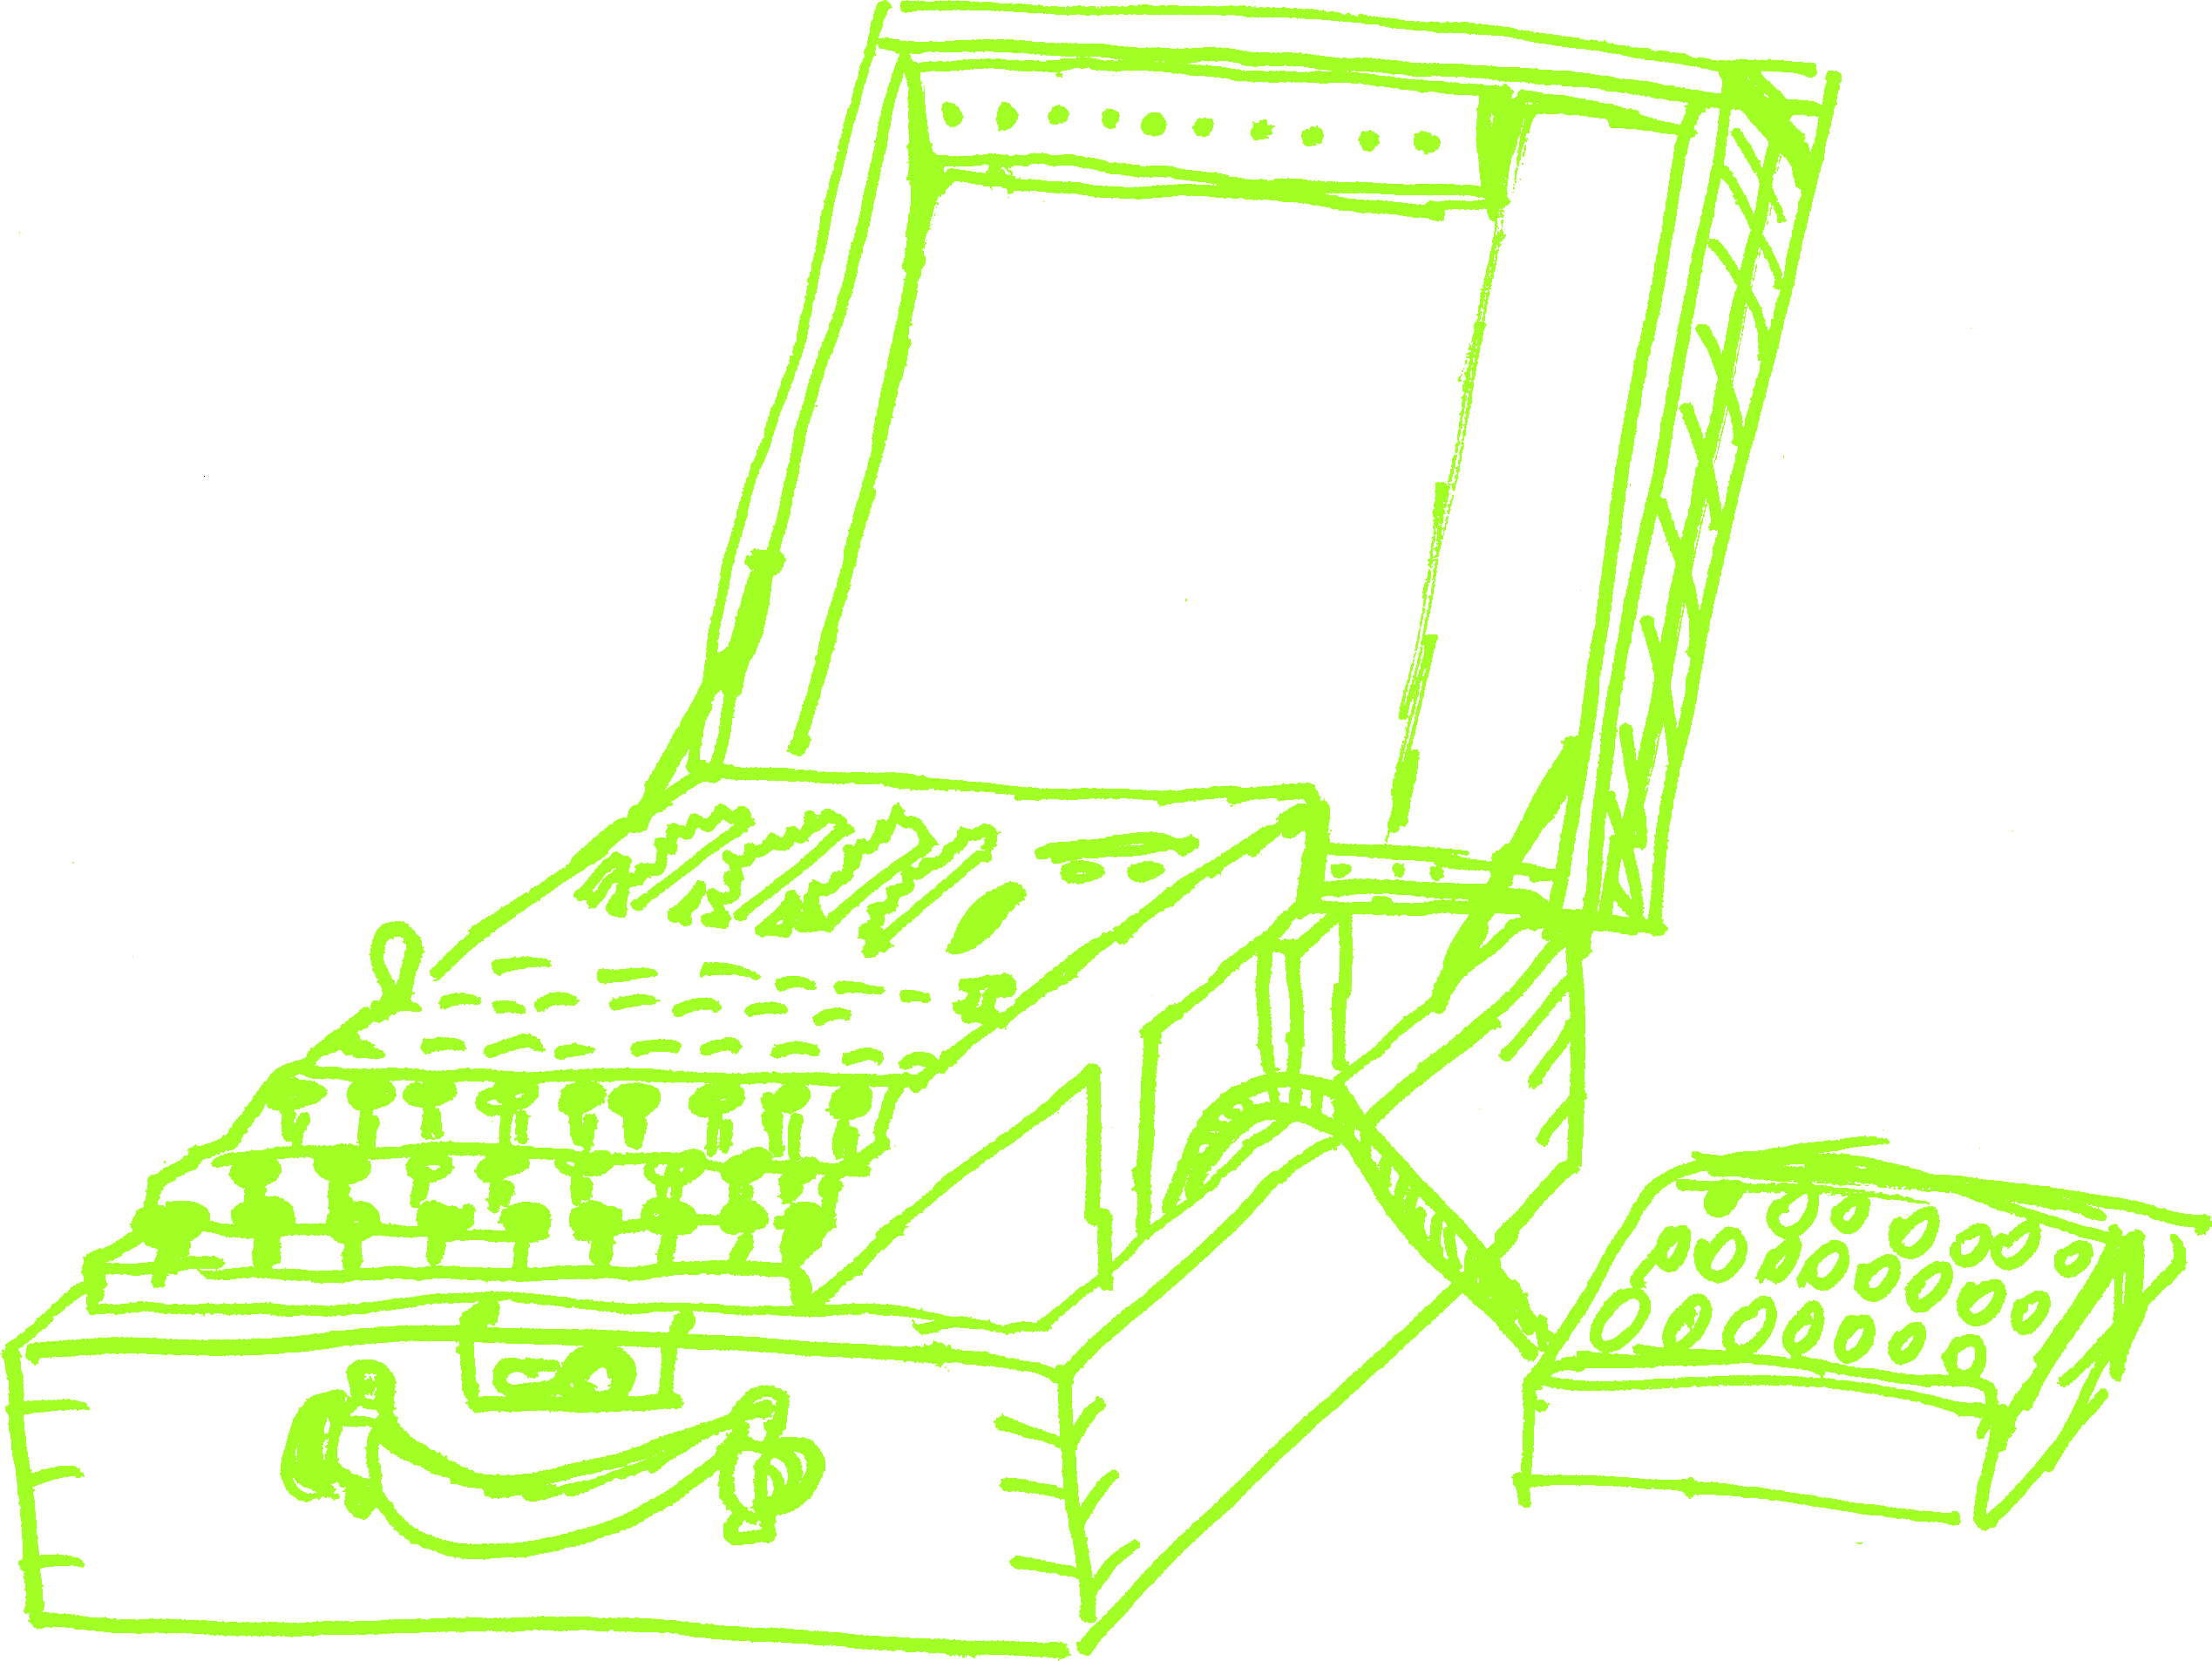
Enigma: History
Developed by Arthur Scherbius in 1920s
Commercially used with three rings

Slide 13
Enigma: Failure
Math behind enigma was cracked by Marian Rejewski in 1932
This didn’t actually break anything
Actual breaking happened later that year
French spy Hans-Thilo Schmidt obtained daily keys
British cracked five-rotor machine in Bletchley Park in 1941
Notes:
Q&A:
Daily keys were for period of September and October 1932
Breaking – no physical machine was stolen

Slide 14
Enigma: Lessons
Output must be random
Correlations are killer
Bigger key space makes a difference
Attack on partial rounds can always be expanded
Notes:
Q&A:
random – output never resulted in the same letter
correlations – due to how machine worked, first and fifth rotor were correlated, second and forth too

Slide 15
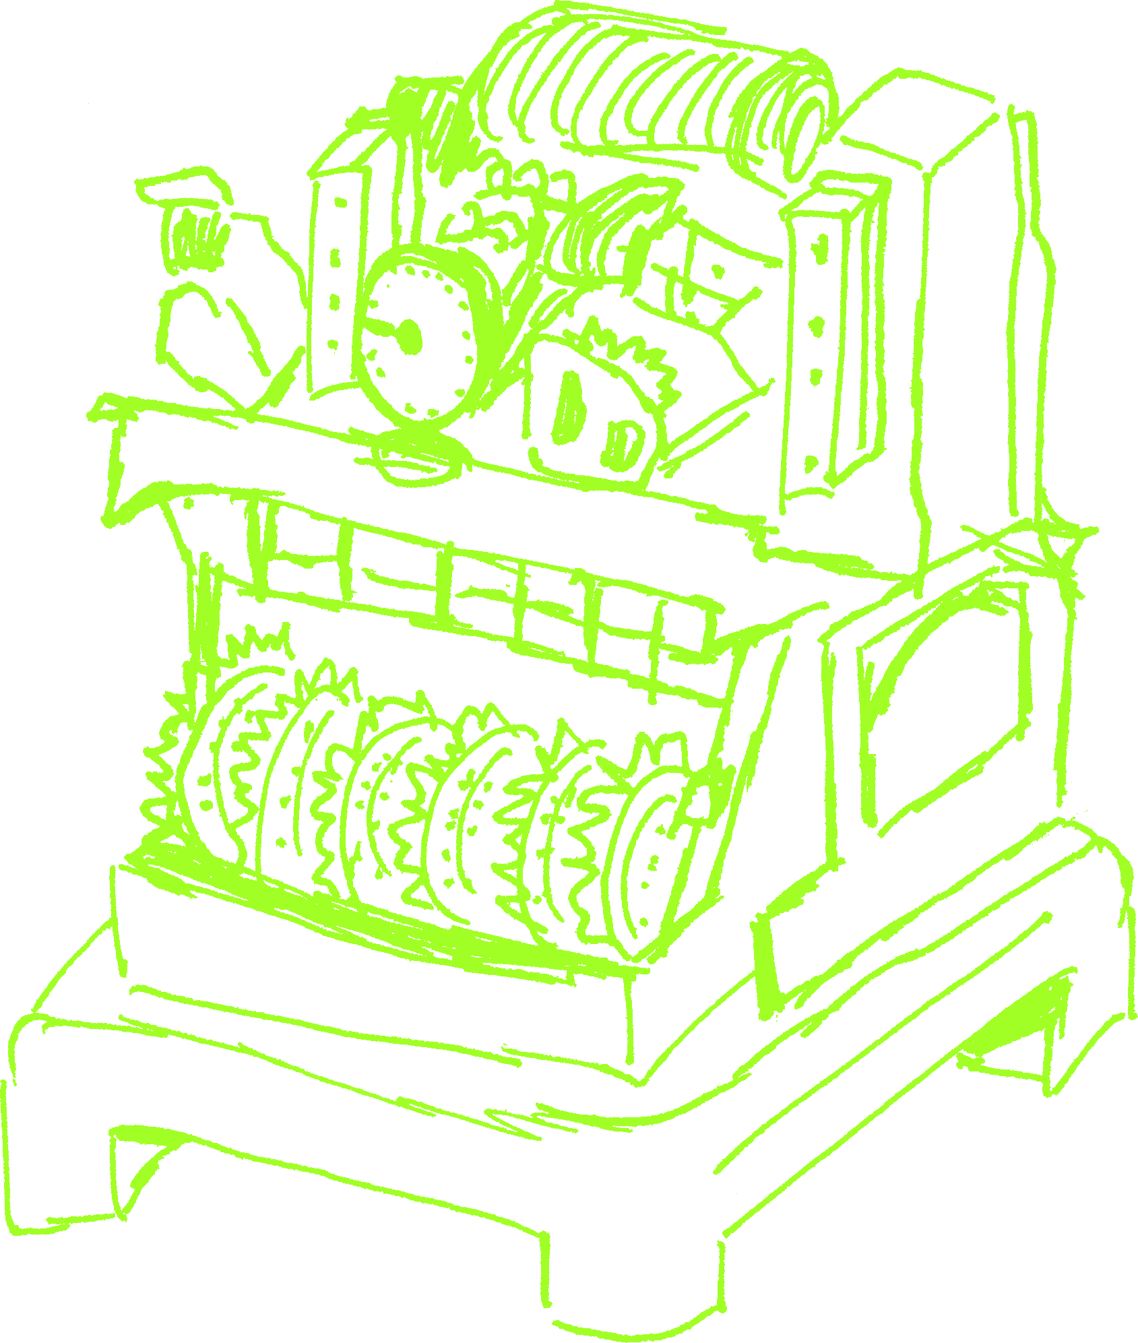
Lorenz
Rotor stream cipher
In-line attachment to standard teleprinters
First encryption method using (relative) primes
Nicknamed Tunny by British
Notes:
Q&A:
Twelve rotors
Enigma was called sawfish
Resources:
https://en.wikipedia.org/wiki/Lorenz_cipher
https://en.wikipedia.org/wiki/Fish_(cryptography)

Slide 16
Lorenz: History
Based on work by Gilbert Vernam at AT&T Bell Labs in 1917
XOR baby!
First experimental link (SZ40) in June 1941
Used for army communications from mid-1942
with variants SZ42A and later SZ42B

Slide 17
Lorenz: Failure
4000 character message sent in August 1941 from Athens to Vienna
receiving operator asked for repeat
sending operator repeated message with the same key but slight abbreviations
both plain texts were extracted together with their key
Bill Tutte discovered 41-character repetition pattern
most of team working with him later worked on Enigma

Slide 18
Lorenz: Lessons
Don’t encrypt different plaintext with the same key
EVER
Don’t leak encryption state information
Unencrypted header accompanied Lorenz traffic
Don’t get fancy
Notes:
Q&A:
12-letter header – called indicator – replaced by 2-letter index
Leak – QEP books started to be used in October 1942
fancy – two extra wheels controlled stutter – i.e. mixing of two streams – made it actually easier to decrypt

Slide 19
MD-5
Designed by Roland Rivest in 1991
128-bit hash
Notes:
Resources:
https://en.wikipedia.org/wiki/MD5

Slide 20
MD-5: History
1993: pseudo-collision
1996: first full collision is found
2004: distributed birthday attack
2005: document content collision
2008: changing end-certificate to intermediate CA
2010: first single-block collision published
2013: second single-block collision – published with source and documentation
Notes:
Q&A:
* distributed birthday attack – too 6 months

Slide 21
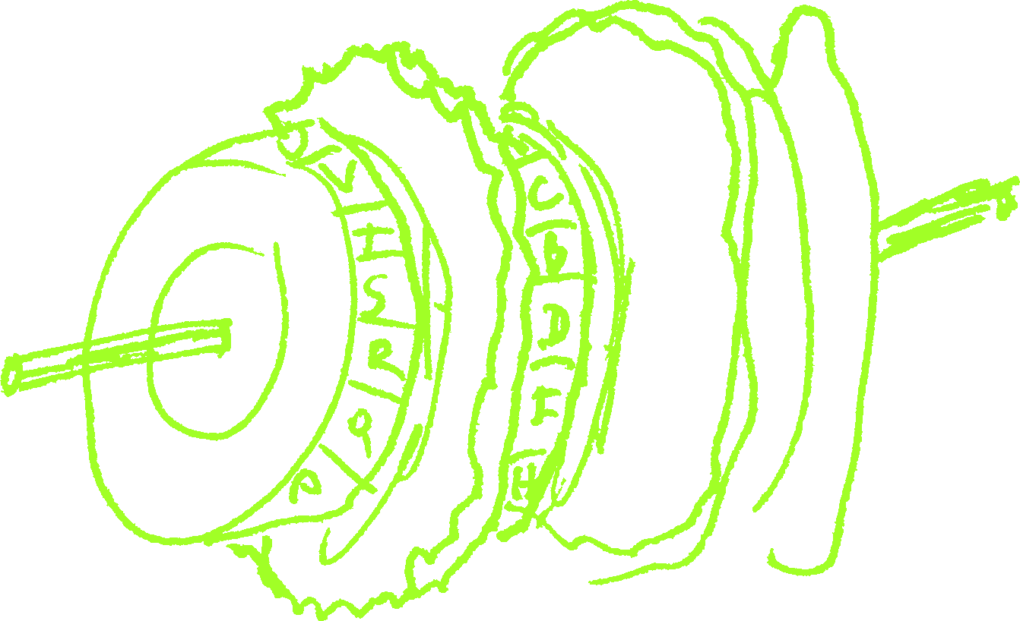
MD-5: Attacks
2012: Flame malware forged Windows update certificate

Slide 22
MD-5: Lessons
Allow algorithms to change over time
quite a few applications had 16 bytes for hash hardcoded
Replace algorithms early
Symantec phased MD-5 out starting in 2009
Microsoft phased MD-5 certificates in 2014
still often used in anti-virus industry
Notes:
Q&A:
Microsoft – they still allow MD-5 for their certificates
Resources:
https://jumpespjump.blogspot.com/2014/03/stop-using-md-5-now.html
https://www.mscs.dal.ca/~selinger/md5collision/

Slide 23
SHA-1
Designed as part of US government Capstone project
authored by NSA
original implementation (now called SHA-0) was slightly corrected
Published in 1995
160-bit
Notes:
Q&A:
SHA-0 was indeed broken sooner than SHA-1
Resources:
https://en.wikipedia.org/wiki/SHA-1
https://en.wikipedia.org/wiki/Capstone_(cryptography)

Slide 24
SHA-1: History
2005: reduced version attack (53 rounds)
2006: two-block collision
2010: single-block attack extended to 73
2015: first full collision (aka SHAppening)
2017: first public collision (aka SHAttered)
2017: SSL certificates not accepted by major browsers
Notes:
Q&A:
reduced version – 53 rounds (out of 80)

Slide 25
SHA-1: Lessons
Allow algorithms to change over time
quite a few applications had 20 bytes for hash hardcoded
Replace algorithms early
Major browsers abandoning only in 2017
Still often used
Notes:
Resources:
https://github.com/git/git/blob/v2.19.0/Documentation/technical/hash-function-transition.txt

Slide 26
How attacks look these days?

Slide 27
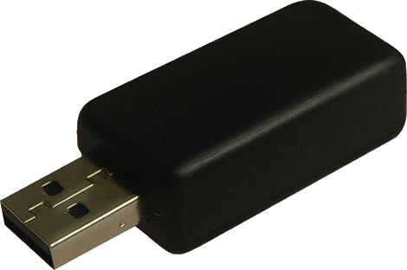
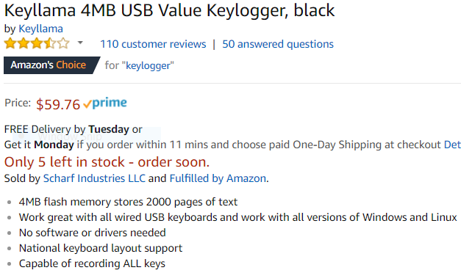
Keyloggers
Notes:
Resources:
https://www.amazon.com/Keyllama-4MB-Value-Keylogger-black/dp/B004ZGXU48

Slide 28
Keyloggers
Software keyloggers are easier
FBI Magic Lantern (as of 2001)
also captures web history, network ports, and passwords stored
CIPAV (Computer and Internet Protocol Address Verifier, as of 2007)
captures location information and IP addresses computer connects to
Notes:
Q&A:
as of 2001 – FBI used “commercial” keyloggers before
Resources:
https://www.wired.com/2016/05/history-fbis-hacking/

Slide 29
Nicodemo Salvatore Scarfo
1999
Cosa nostra
14 years in prison
Used encryption!
Used dial-up!
remote connection unlikely
FBI broke into his offices twice :)
Notes:
Resources:
https://www.wired.com/2016/05/history-fbis-hacking/

Slide 30
Larry Ropp
2004
Spied on his employer
Dismissed
KEYKatcher
Did not violate federal wire-tap law
Notes:
Resources:
https://www.theregister.co.uk/2004/11/20/judge_dismisses_keylogger_case/

Slide 31
Josh Glazebrook
2007
Washington school bomb threats
90 days in custody
Handwritten notes
Anonymous e-mail
Anonymous MySpace profile
Anonymous VPN
FBI installed CIPAV on MySpace profile
Notes:
Q&A:
CIPAV was used to get IP address
Resources:
https://abcnews.go.com/Technology/story?id=3389624

Slide 32
Keyloggers: Advice
Check occasionally for rogue USB devices
Watch what you click
Think about reinstalling your computer from time to time
Cover camera?
Notes:
Resources:
https://www.engadget.com/2016/09/23/the-fbi-recommends-you-cover-your-laptops-webcam-good-reasons/

Slide 33
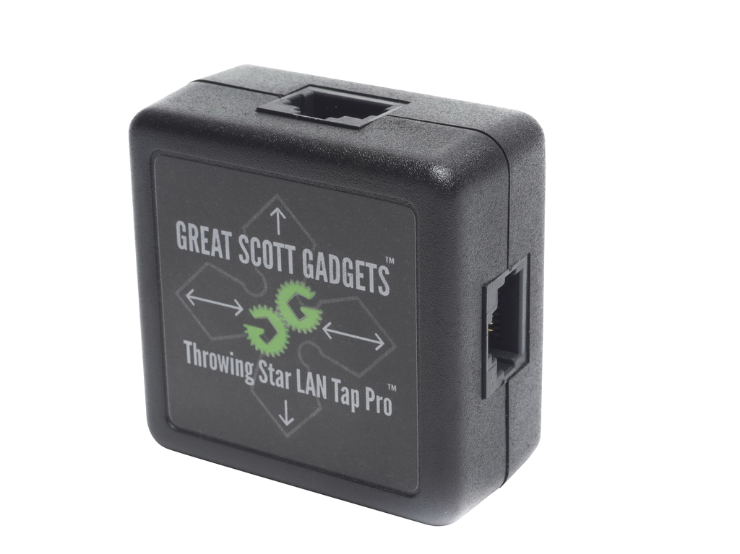
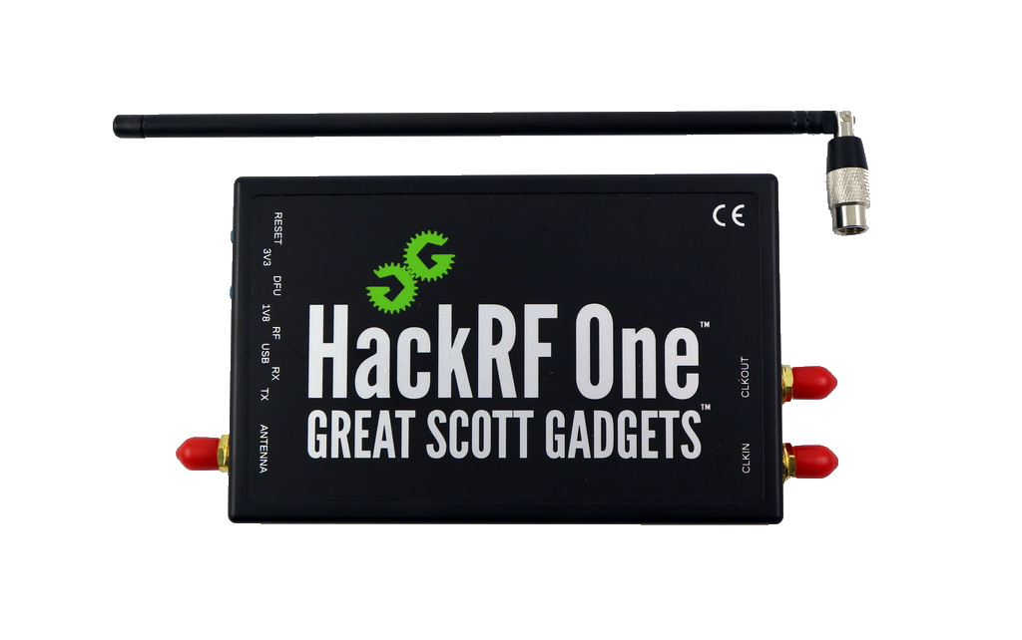
Network Interception
Notes:
Resources:
https://hackerwarehouse.com/product/lan-tap-pro/?gclid=CjwKCAjw_IPcBRAjEiwAl44QkciYgL4y-Hp6VrwO1DKDAlQBQPdDYAGmcVEmXVTBeHVWct6mkOX31BoCPZsQAvD_BwE
https://hackerwarehouse.com/product/hackrf-one-kit/

Slide 34
Network Interception
Useful for pen-testing
You get it for free on public wireless
Western District of Pennsylvania
available to attorneys, other legal staff and the media
in terms: “we reserve the right to log or monitor traffic”
Notes:
Resources:
https://hackerwarehouse.com/product/lan-tap-pro/?gclid=CjwKCAjw_IPcBRAjEiwAl44QkciYgL4y-Hp6VrwO1DKDAlQBQPdDYAGmcVEmXVTBeHVWct6mkOX31BoCPZsQAvD_BwE
https://hackerwarehouse.com/product/hackrf-one-kit/

Slide 35
Gogo Inflight
2016
Man-in-the-middle attack
Issues fake SSL certificates
“to better serve consumer”
throttling, naughty site protection...
and CALEA
Nothing to see here – part of privacy policy
Notes:
Resources:
https://www.csoonline.com/article/2865806/cloud-security/gogo-inflight-internet-serves-up-man-in-the-middle-with-fake-ssl.html
https://arstechnica.com/information-technology/2016/02/why-you-probably-shouldnt-be-doing-work-on-that-in-flight-wi-fi/
https://www.techdirt.com/articles/20150105/09344429597/gogo-inflight-wifi-service-goes-man-in-the-middle-issues-fake-google-ssl-certificates.shtml

Slide 36
Starbucks*
2017
Man-in-the-middle attack
* Starbucks were not actually involved – just their store
Public WiFi was hacked
Customer laptops were taken over by rogue JavaScript
Monero mining
Notes:
Resources:
https://www.cnbc.com/2017/12/12/starbucks-customer-laptops-hacked-to-mine-cryptocurrency.html
http://www.pawd.uscourts.gov/wireless-internet-access

Slide 37
VPNfilter
2018
Russian botnet
Fancy bear group :)
Seized by FBI
Targets devices using Modbus protocol
industrial hardware control
500,000 devices infected
50ish router models
Asus, D-Link, Huawei, Linksys, Mikrotik, Netgear, QNAP, TP-Link, Ubiquity, Upvel, ZTE
Notes:
Q&A:
reboot your router
Resources:
https://www.engadget.com/2018/05/24/fbi-seizes-domain-russian-botnet/
https://www.cnet.com/news/the-fbi-wants-you-to-reboot-your-router-now-to-help-destroy-a-botnet/

Slide 38
Network Interception: Advice
Always use VPN on public networks
Make sure your internal communication is encrypted too
Update firmware regularly
Notes:
Resources:
https://hackerwarehouse.com/product/lan-tap-pro/?gclid=CjwKCAjw_IPcBRAjEiwAl44QkciYgL4y-Hp6VrwO1DKDAlQBQPdDYAGmcVEmXVTBeHVWct6mkOX31BoCPZsQAvD_BwE
https://hackerwarehouse.com/product/hackrf-one-kit/

Slide 39
Backdoors
Accidental
Debian’s OpenSSL issue in 2008
Intentional
elliptic curve RNG
Hardware-based
Notes:
Resources:
https://en.wikipedia.org/wiki/Hardware_backdoor
https://en.wikipedia.org/wiki/Random_number_generator_attack
https://www.wired.com/2016/06/demonically-clever-backdoor-hides-inside-computer-chip/
https://www.schneier.com/blog/archives/2018/03/adding_backdoor.html
https://www.technologyreview.com/s/519661/nsas-own-hardware-backdoors-may-still-be-a-problem-from-hell/

Slide 40
DEbian OpenSSL
Broken in 2006
Fixed in 2008
Bug limited number of keys to 32,768
Also present on Debian’s derivative
e.g. Ubuntu
Probably some of these keys are present today too
Notes:
Resources:
https://en.wikipedia.org/wiki/OpenSSL
https://research.swtch.com/openssl

Slide 41
Dual_EC_DRBG
Published in 2006
Withdrawn in 2014
Weakened encryption
non-transparently chosen initial state
Default in BSAFE
by RSA Security
Non-default in many more
Notes:
Q&A:
initial state – carefully chosen P and Q points
Even affected hardware - Juniper Networks ScreenOS
Resources:
https://en.wikipedia.org/wiki/Dual_EC_DRBG

Slide 42
Simon and Speck
Created in 2013
Rejected by ISO in 2018
Lightweight block ciphers
Optimized for IoT
Notes:
Resources:
https://en.wikipedia.org/wiki/Speck_(cipher)
https://www.cbronline.com/news/nsa-ciphers-iso
https://www.schneier.com/blog/archives/2018/04/two_nsa_algorit.html

Slide 43
Backdoors: advice
Trust no one?
Update software regularly
Update firmware regularly
Physical security is important

Slide 44
Future
IoT encryption algorithms
primary goal is to have it run on weak hardware
Quantum computers
Making RSA obsolete
Politics
Notes:
Resources:
https://www.cbronline.com/news/encryption-breakthrough
https://csrc.nist.gov/projects/lightweight-cryptography

Slide 45
Thank You
Josip Medved
medo64.com
@medo64

